Slide 1
WordPal
Group 36
Nala Rivera
Hilda Deveaux
Daniel Ortiz-Gratacos

Slide 2

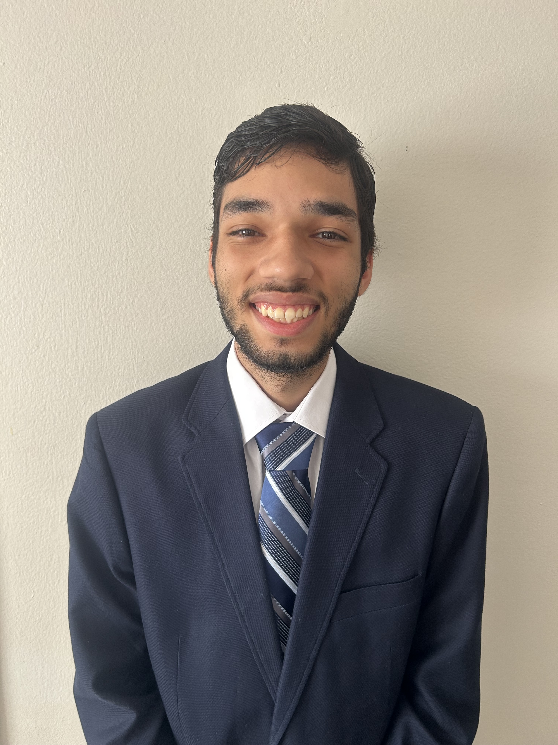
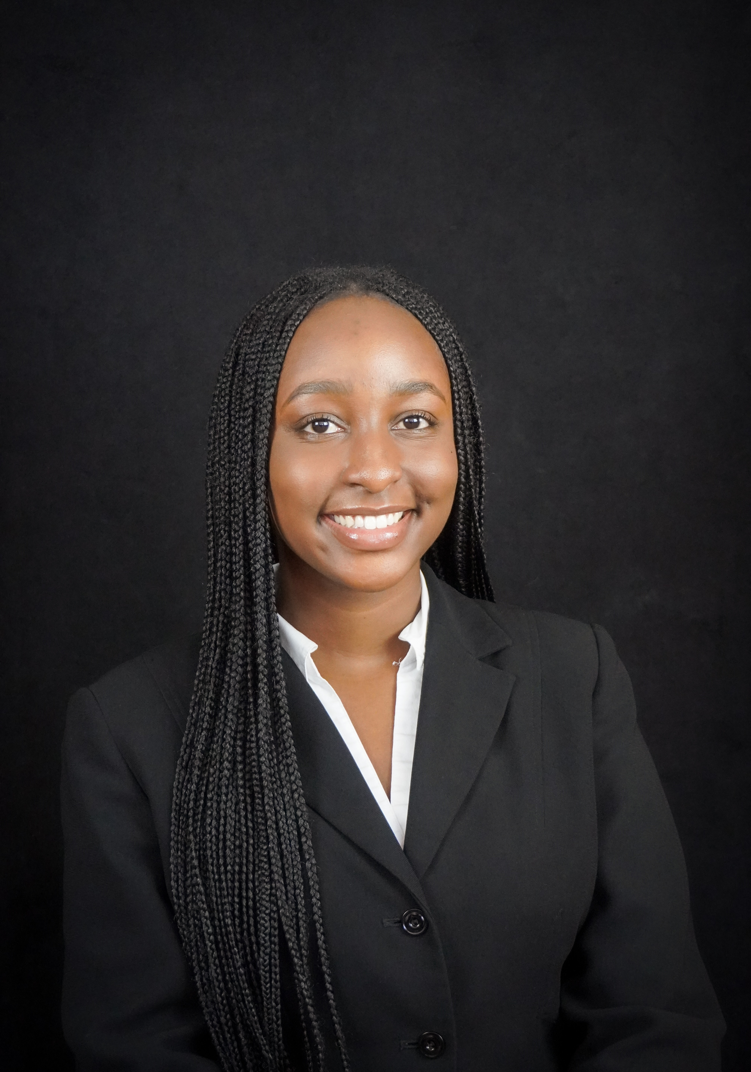
Daniel Ortiz-Gratacos
Computer Engineering
Hilda Deveaux
Computer Engineering
Nala Rivera
Computer Engineering

Slide 3
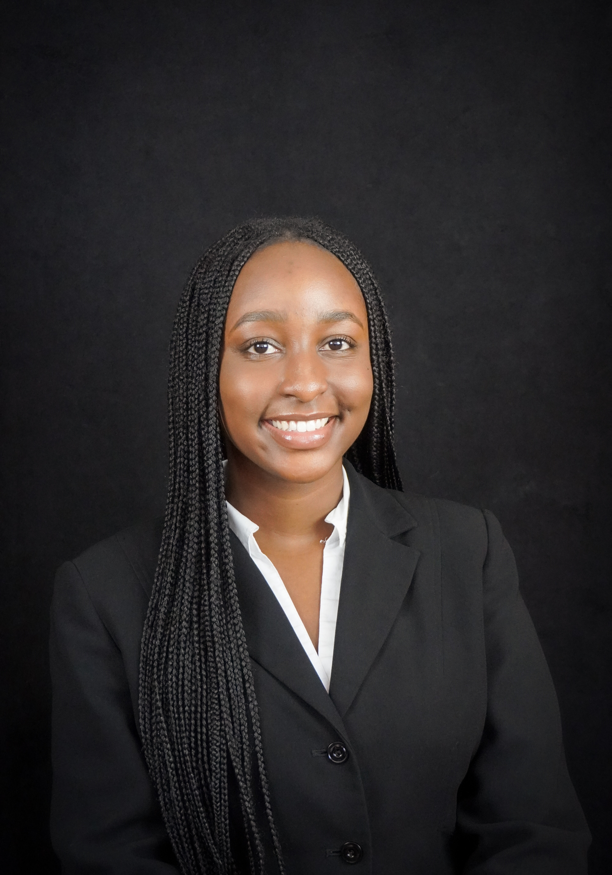
Motivation and Background
Wordle is a popular daily word game that uses color based feedback to guide player guesses
The game is normally played on phones or computers
Our project brings Wordle into a standalone physical device with its own keyboard, display, and lighting feedback
Our goal is to design a portable handheld device that recreates Wordle using real buttons and visual feedback

Slide 4
Goals
Basic
Generation/selection of 5-letter words on device
LCD display to show game progress and interface with user
User input via on-device physical QWERTY keyboard
Feedback via RGB LEDs diffused behind keyboard
Wi-Fi capability via ESP32 (built in), for obtaining daily word
Battery powered
Advanced
Add a buzzer speaker for auditory feedback (and maybe personality)
Allow exporting game results as serial text data via USB-A
Stretch
Create wired local multiplayer through USB-A
Touch screen
Additional word games
Multiple word lengths

Slide 5
Objectives
Basic
Create a Network API to obtain the daily word if necessary
Create an algorithm that pseudo randomly generates words (at least 100 possible words)
Create an algorithm that keeps track of the rounds (default would be 6 rounds)
Create code that allows the player to guess and for the guess to be checked for correctness
Display colors that give hints to the player on the LCD
Display the game playing interface on the LCD
Light up relevant LEDs with the relevant colors that also give hints to the player (implement an LED multiplexer)
Implement a keyboard of 26 letters in the QWERTY format, a backspace, and an enter key
Create code that allows a button to interrupt and do a new game
Implement a 5V regulator circuit
Implement a power switch
Create Wi-Fi configuration code
Power from rechargeable batteries
Advanced
Create the relevant code which allows exporting (implement serial functionality which could include the CP2102 chip and UART)
Create the relevant code that utilizes the buzzer speaker (implement buzzer speaker)
Stretch
Implement LEDs that light up relative to who wins or loses, and this be accomplished through the USB-A cable (and implement the relevant things for wired local multiplayer through USB-A)
Create code that can have smaller or bigger word sizes for the word that needs to be guessed, and rounds adjusted accordingly
Create code for other word games
Implement Touch Screen

Slide 6

Table of Engineering Specifications
General
Dimensions | < 8 in x 5 in x 2 in
Weight | < 200 g
Battery Capacity | > 2000 mAh
Battery Life | > 1 hour
Cost of Materials | < $200
Keyboard
Response Time | Less than 100 ms
RGB LEDs | Addressable, <= 5V, >2 bpc
Display
Response Time | Less than 100 ms
Brightness | > 250 nits
Notes:
Here are our engineering specifications. These remain mostly unchanged from our initial goals for the project. We aimed to keep the dimensions on the smaller end, and we were successful in our goal as will be discussed later. We are on the way to meeting our weight goals, as the significant majority of our weight is accounted for by the display and batteries. Battery capacity is essentially a given, as due to the structure of our battery technology, it's almost impossible to find batteries that do not meet our goal here. With our calculations, we believe the battery life specification should be more than doable, and we think this figure is reasonable for a device that is best used once per day. While our total development budget exceeds this figure, our cost of materials is well under $200; we chose to represent this in our specifications because there is less of a motivation for this device if it is to be more expensive than alternatives.
For both the keyboard and display response times, our microcontroller is plenty capable of this speed. The LEDs we are using meet our requirement, and the display meets our brightness requirement.

Slide 7
House of Quality
 |  |  |  |  |  |  |  | ↓
 |  |  |  |  |  |  |  |  | ↓
 |  |  |  |  |  | ↓ |  |  |  | ↓
 |  |  |  |  |  |  | ↓ |  | ↓ |  | ↑
 |  |  | Design Requirements | Response Time |  | Display Brightness |  | Battery Capacity |  | Weight/Dimensions |  | Cost
 |  |  |  | - |  | + |  | + |  | - |  | -
Customer Requirements | Ease of Use |  | + | ↑ |  | ↑ |  | ↓ |  | ↓ |  | ↑
 | Portability |  | + |  |  |  |  | ↓ |  | ↑
 | Battery Life |  | + | ↓ |  | ↓↓ |  | ↑↑ |  | ↑ |  | ↓↓
 | Charge Time |  | - |  |  |  |  | ↓ |  |  |  | ↓↓
 | Cost |  | - | ↓ |  | ↓ |  | ↓ |  |  |  | ↑↑
Targets |  |  |  | <100 ms |  | > 250 nits |  | >1000 mAh |  | <= 8x5x2in, <=200g |  | <$200 excluding prototyping

Slide 8
Processor Technology Comparison
Microcontroller far more cost-effective
No need for the level of performance of the other two options
Familiarity with developmental processes
Microcontroller allows for simpler and more compact PCB
Easy decision
Characteristic | MCU | SoC | FPGA
Cost | Affordable | Expensive | Very Expensive
Power Efficiency | Excellent | Fair | Poor
Performance | Fair | Good | Excellent
Flexibility | Fair | Fair | Excellent
Software Development | Moderate | Moderate | Difficult
PCB Development | Simple | Moderate | Difficult
Physical Size | Small | Medium | Large
Notes:
Here is the comparison table between central processor technologies. While FPGAs and SOCs are quite powerful, we believe that they do not fit our purposes nearly as well as the MCU. The MCU is cost- and power-efficient, performs well enough to meet our needs, and is relatively easy to design our PCB and software around. We all also have experience developing for an MCU from Junior Design, as well as various technical courses on our path to Senior Design. For those reasons, we decided that the microcontroller is the best technology to build around.

Slide 9
Microcontroller Comparison
Shared prior experience with MSP430 family
Need memory for storing graphics and user data
Need at least PRNG for random word selection
ESP32 has Wi-Fi capabilities, allowing us to fetch words over online APIs
MSP430 is ancient, RP235x brand-new, ESP32 is in the middle
ESP32 popular with hobbyists
  Greater wealth of information available
Characteristic | TI MSP430 | RP2350/2354 | ESP32
Chip Cost | ≤$5 | $1-2 | $2-4
Dev Board Cost | $20-30 | $7-8 | $10-20
Speed | Up to 25MHz | Up to 150MHz | Up to 240MHz
Volatile Memory | Up to 66KB | 520KB | 520KB
Flash Memory | Up to 512KB | RP2350: none RP2354: 2MB | 448KB ROM Up to 16MB
Serial Connectivity | UART, SPI, I2C, USB | USB, UART, SPI, I2C, HSTX | USB, UART, SPI, I2C
Other Peripheral Interfaces | Touch, temp sensor, ADC, LCD, PWM | Touch, temp sensor, ADC, | Touch, Ethernet, IR, PWM, I2S, ADC, DAC
Other Features | AES, RTC | TRNG, crypto | Wi-Fi, Bluetooth, TRNG, crypto, RTC, USB-OTG
Physical Size (mm) | Varies, commonly from 3x3-16x16 | 7x7 QFN, 10x10 SMD | Publicly available as ~20x20 WROOM module
Notes:
For microcontroller families, we decided between the TI MSP430 family, Raspberry Pi RP2350/2354, and the ESP32 family. Despite our shared experience working with the MSP430 in prior engineering classes, we quickly ruled it out due to its age and relatively poor ease of use compared to the other two families. The RP2350/2354 were enticing, but they are too bleeding-edge. In the end, the ESP32 line is the only one of these three that can meet our needs, due to its Wi-Fi capability and flash storage.

Slide 10
Display Technology
E-ink far more efficient, but far too slow and limited for our needs, on top of cost
OLED more efficient than LCD, but much more expensive than an LCD of the same size or resolution
Characteristic | LCD | OLED | E-ink
Cost | $20-50 | $50+ | $50+
Power Efficiency | Decent | Great | Excellent
Brightness | Backlit, decent | Good | None
Contrast | Good | Excellent | Good
Colors | 8bpc | 8bpc | 2-4 colors total

Slide 11
Battery Technology
Property | Lithium-ion | NiMH (AA)
Nominal voltage | 3.7V | 1.2V
Capacity (mAh) | 2000-3000 | 2200-2800
Discharge rate | Up to 10C (risky) | Up to 3C
Weight | Moderate | Moderate
Shape / form | Cylindrical cell | Cylindrical cell
Safety Risk | Moderate | Relatively low

Slide 12
Power Table
Component | Voltage | Current | Power Consumption
ESP32-S3 MCU | 3.3V | ~ 350mA | 1.16 W
TFT Display | 3.3V | ~ 100mA | 0.33 W
RGB Key LEDs | 5.0V | 15mA * 26 = 400 mA | 1.95 W
QWERTY Keyboard | 3.3V | 10mA | 0.033 W
NiMH Batteries (2) | 2.4V | 2A maximum output | 2500 mAh capacity

Slide 13
Programming Environment Comparison
Arduino Core for ESP32’s downsides in mixed quality of libraries and second highest performance typically are not too problematic for this project, and the upsides may make it a suitable choice.
Criteria | Arduino Core for the ESP32 | ESP-IDF | MicroPython
Ease of Use | Beginner Friendly | Intermediate/Advanced | Beginner Friendly
Programming Language Support | C, C++, Arduino Programming Language | C, C++ | Python
Library Support | Many Libraries with Mixed Quality | Many Libraries with Better Average Quality relative to Arduino | Many Libraries with Better Average Quality relative to Arduino
Performance | Second Highest Performance Typically | Highest Performance Typically | Third Highest Performance Typically
Suitability for Prototype Development | Suitabe for Rapid Prototyping | More Suitable for Professional Grade Solutions | Suitable for Rapid Prototyping

Slide 14
Display Library Comparison
The choice might be more between TFT_eSPI and LovyanGFX. TFT_eSPI’s performance is not that much of a downside, and it might be overall easier compared to LovyanGFX. There was the potential for TFT_eSPI not working out, but so far it has.
Criteria | TFT_eSPI | Adafruit GFX | LovyanGFX
Ease of Use | Beginner to Intermediate in terms of Setup Beginner in terms of most functions Beginner to Intermediate in terms of Sprites | Beginner to maybe Intermediate in terms of Setup Beginner in terms of most functions Beginner to Intermediate in terms of Canvas | Beginner to Advanced in terms of Setup Beginner in terms of most functions Beginner to Advanced in terms of Sprites
Feature Set / Capability | Graphics Primitives, Text, Fonts, Sprites, Some Anti-Aliasing, Partial Screen Updates, etc. | Graphics Primitives, Text, Fonts, Canvas, etc. | Graphics Primitives, Text, Fonts, Sprites, Color Formats, etc.
Performance | Second Highest Performance Typically | Third Highest Performance Typically | First Highest Performance Typically

Slide 15
LED Control Comparison
Criteria | FastLED | Adafruit NeoPixel | pololu-led-strip-arduino
LED Compatibility | Supported LED Chipsets include: WS2812B, APA102, SK6812, WS2813, and more Multiple LED Protocols Supported | Supported Chipset Families Include: WS2812, WS2811, SK6812, and more | Supported Strips: low-speed TM1804 (requires a lower version like 1.2.0), high-speed TM1804, SK6812, and WS2812B WS2811 LEDs Also Supported
Ease of Use | Beginner to Intermediate in terms of setup and code | Beginner to Maybe Lower Intermediate in terms of setup Beginner in terms of code | Beginner to Maybe Lower Intermediate in terms of setup Maybe Intermediate in terms of code
Performance | Theoretically Faster than Adafruit NeoPixel Experimentally Inconclusive | Theoretically Slowest Experimentally Inconclusive | Theoretically Fastest
FastLED’s bigger LED Compatibility does edge it out over the others. The ease of use is maybe not too bad for WordPal. The performance seems to be indefinite, so that may affect future usage of it.

Slide 16
Wi-Fi Software Stack and Optional Layers Comparison
Criteria | Arduino-esp32 Wifi.h | WiFiManager | AsyncTCP
Ease of Use | Beginner in terms of setup and code | Beginner to Maybe Intermediate in terms of setup Beginner in terms of code | Beginner to Maybe Intermediate in terms of setup Maybe Intermediate to Advanced in terms of code
Feature Set | ESP32 WiFi can run in different WiFi modes: WiFi Station, Access Point, Access Point + Station Mode, and Promiscuous mode. It can scan WiFi networks, connect to a WiFi network, check ESP32 WiFi connection strength, and more. | It allows one to provide Wi-Fi credentials from the outside, do on-demand configuration, and add custom parameters. | AsyncTCP allows for multiple connections and makes up the base for ESPAsyncWebServer.
Dependencies | What’s necessary in the Arduino Core | DNSServer-ESP32 library, WebServer-ESP32 library, Wifi.h, and What’s necessary in the Arduino Core | Wifi.h, and What’s necessary in the Arduino Core
Wifi.h is a required choice, but using it by itself might make the most sense. AsyncTCP add unnecessary complexity for no practical gain. WiFiManager integration could be an additional feature added on.

Slide 17
Hardware Block Diagram
Data
Power
Keyboard
Network API
LCD Display
MCU (ESP32)
RGB Key LEDs
3.3V Regulator Circuit
5V Regulator Circuit
NiMH Battery
USB-A Port

Slide 18
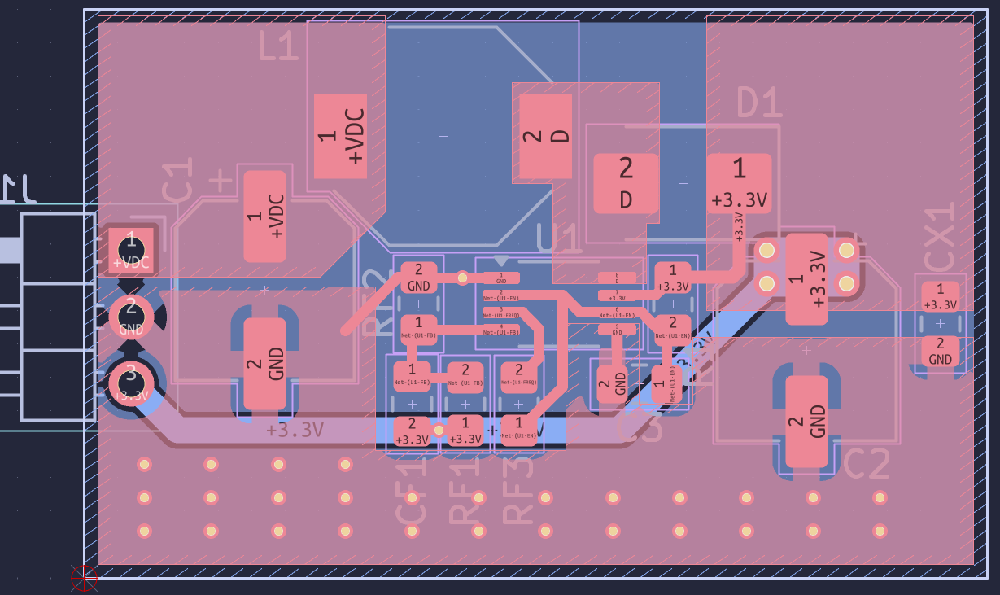
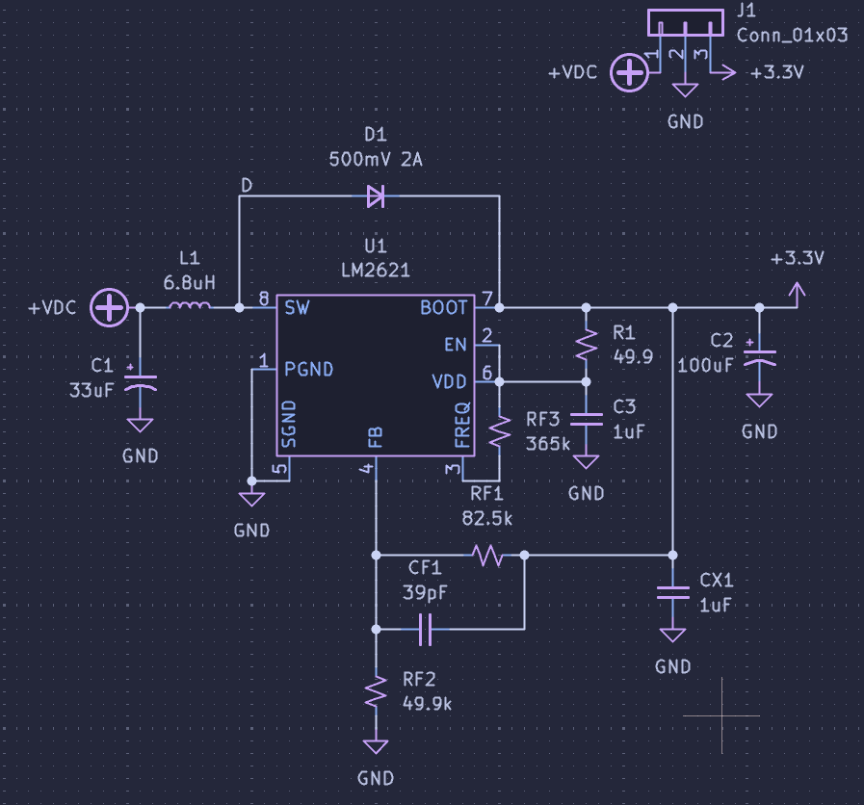
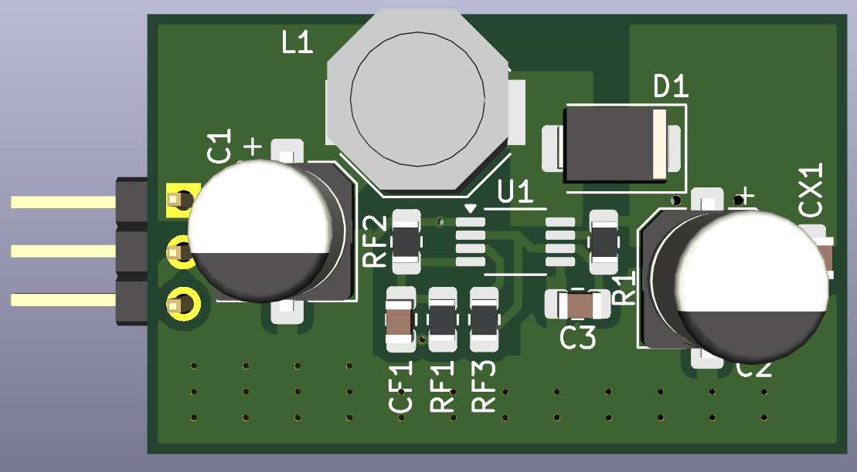
3.3V Regulator

Slide 19
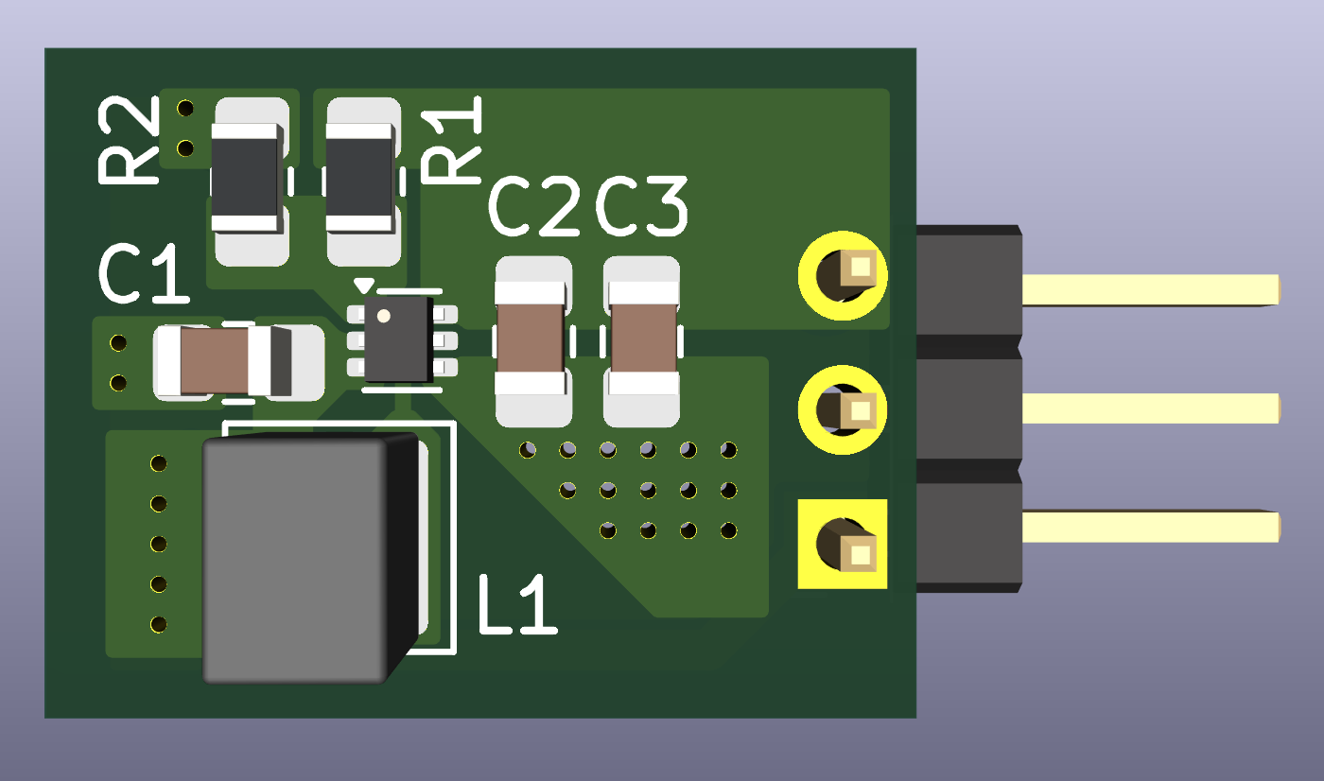
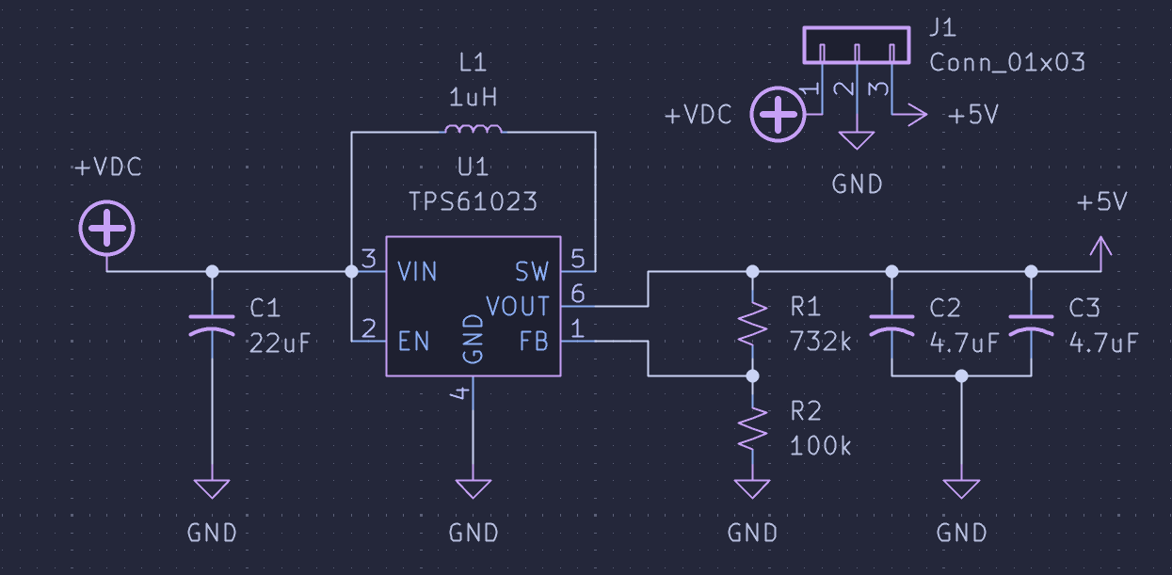
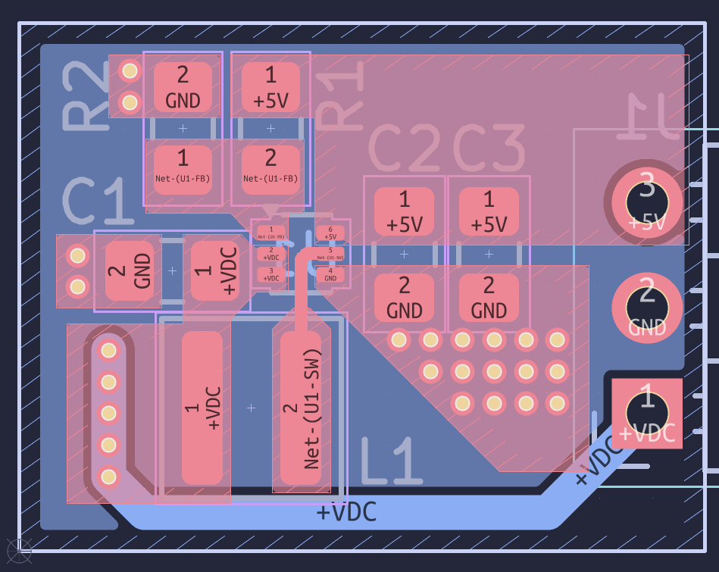
5V Regulator

Slide 20
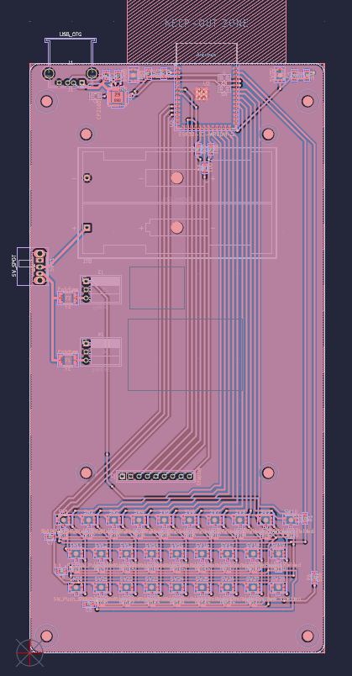
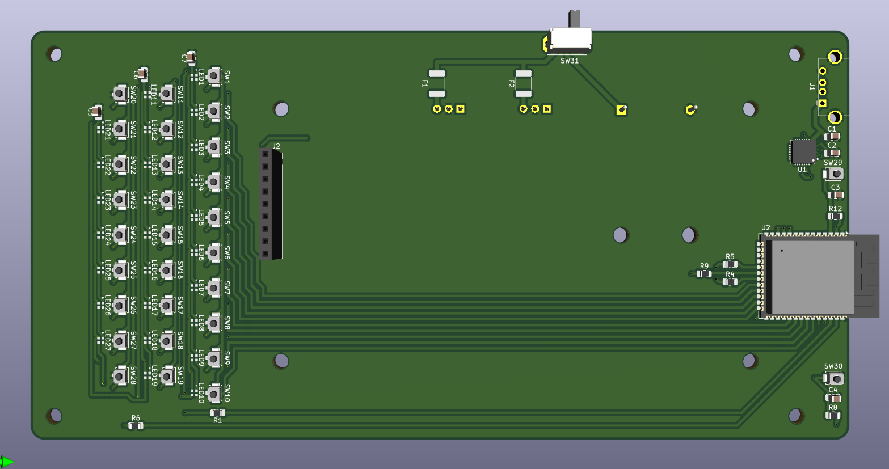
Main Board

Slide 21
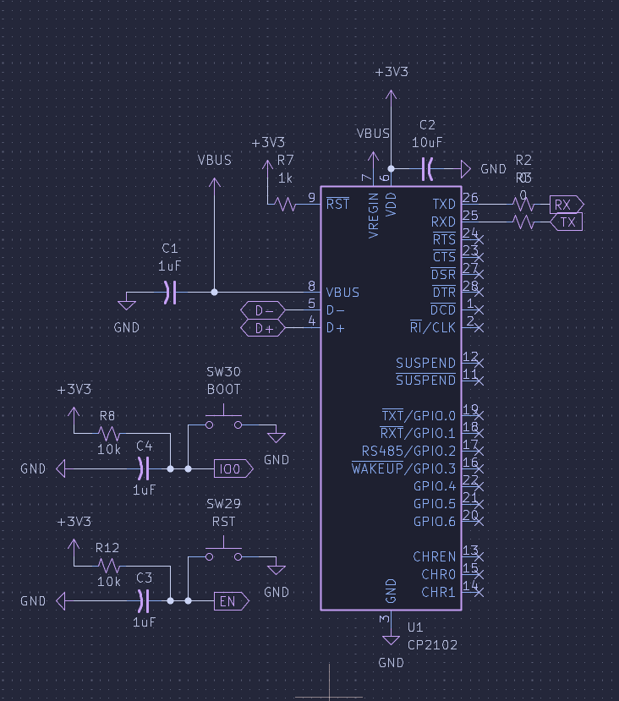
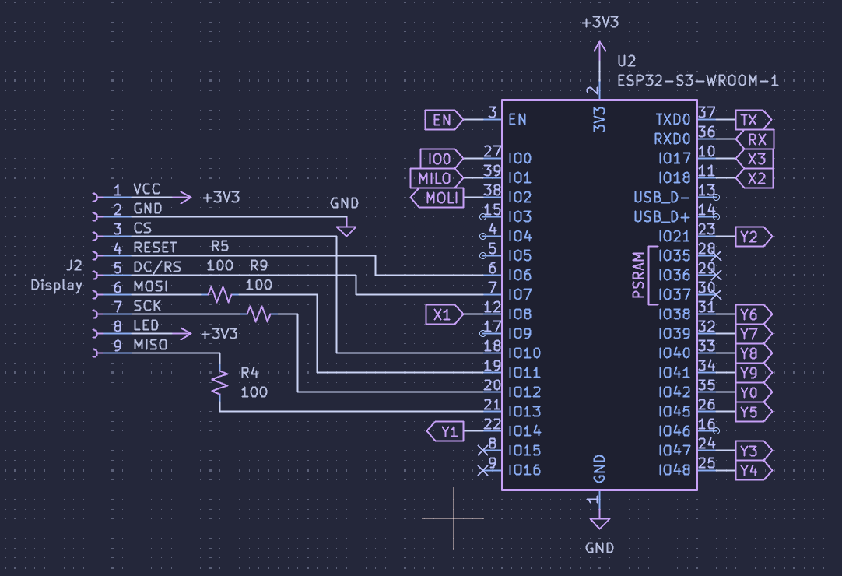
ESP32
CP2102

Slide 22
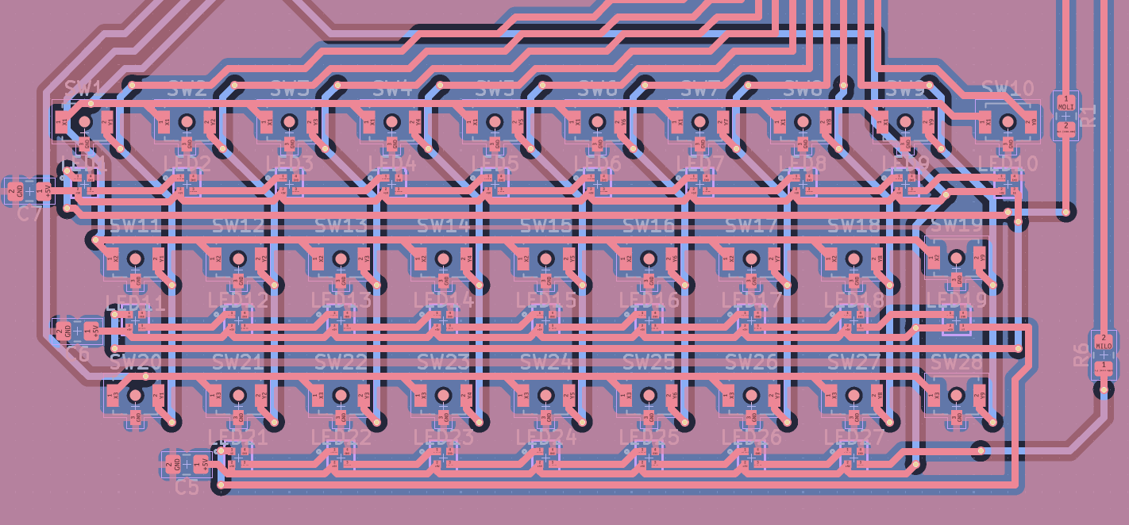
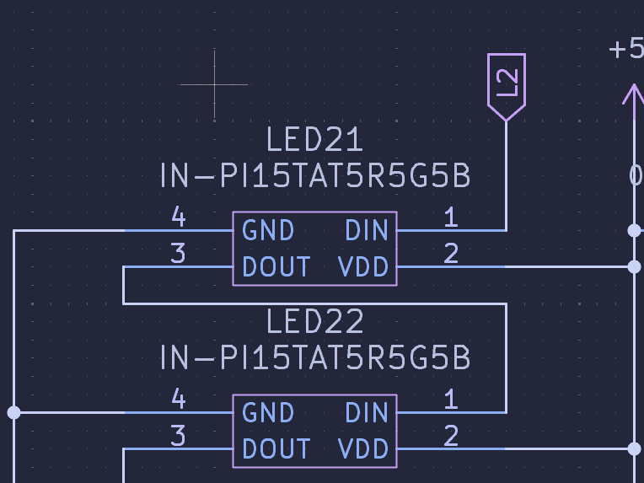
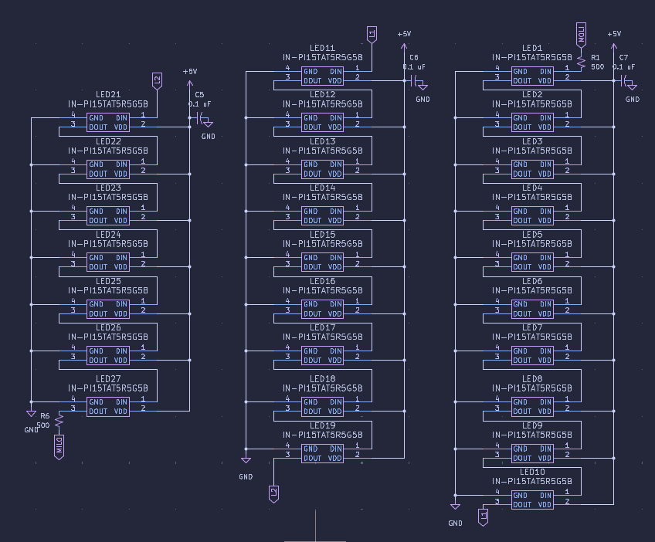
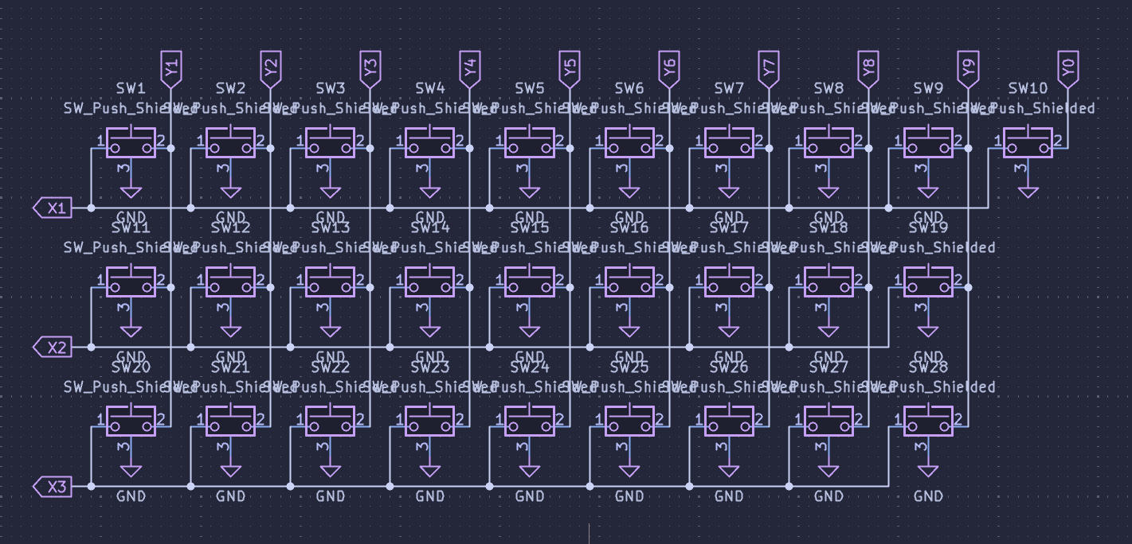
Keyboard and Lighting

Slide 23
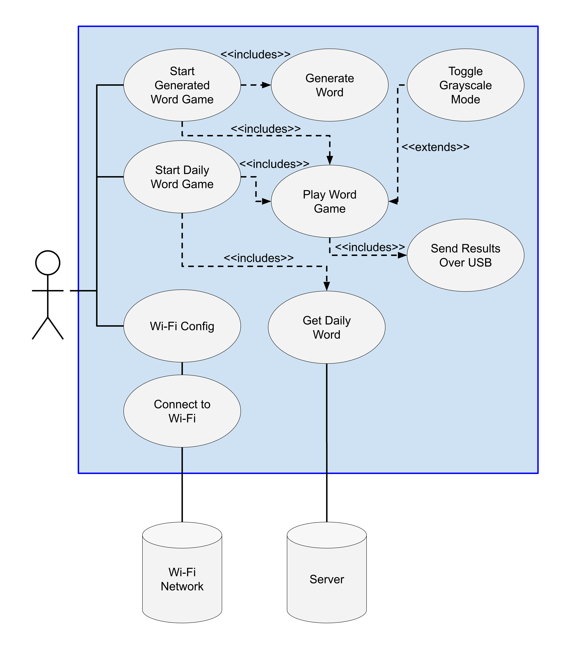
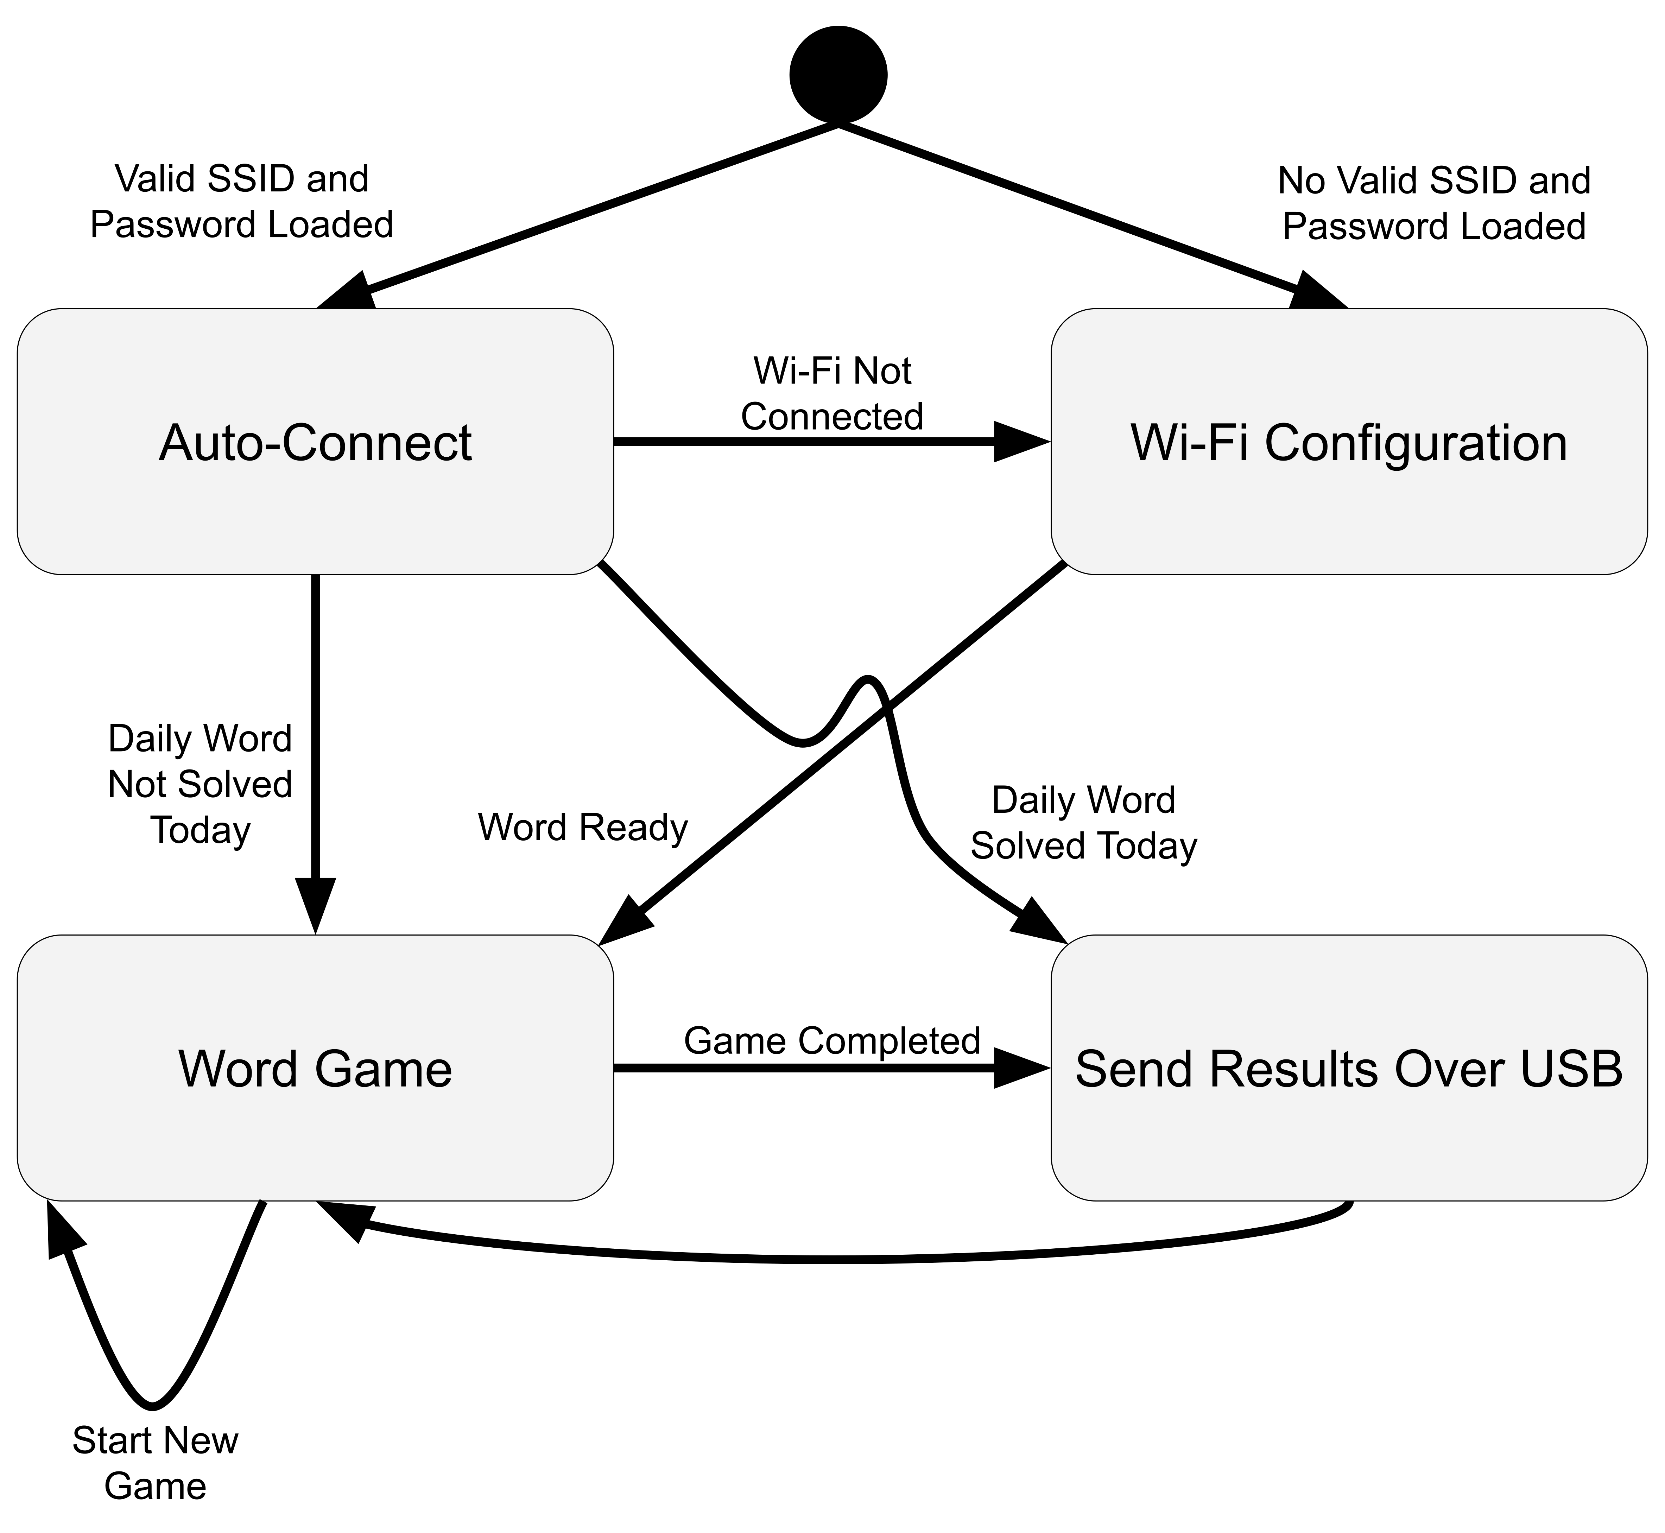
Software Design

Slide 24
Software Design

Slide 25
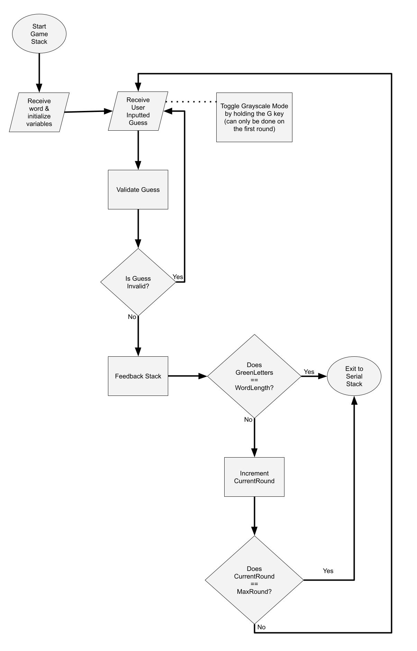
Software Design

Slide 26
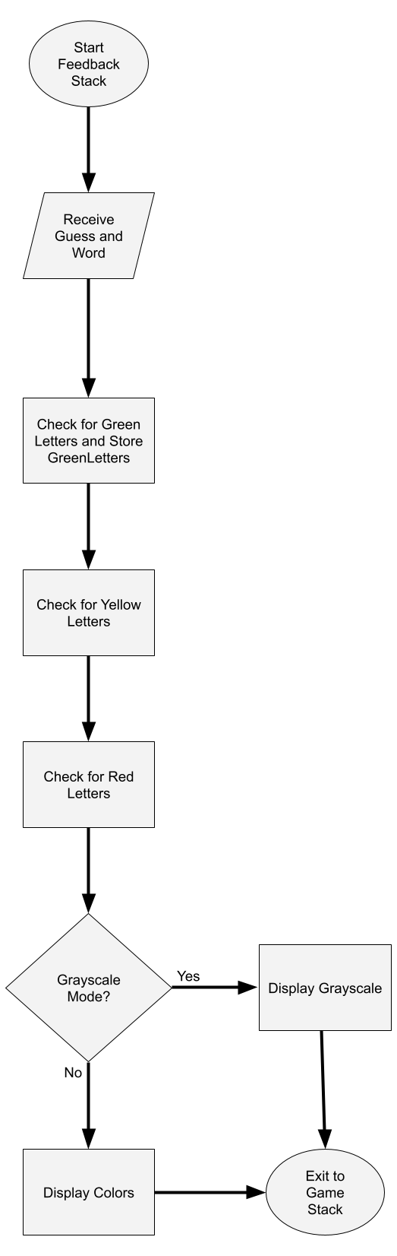
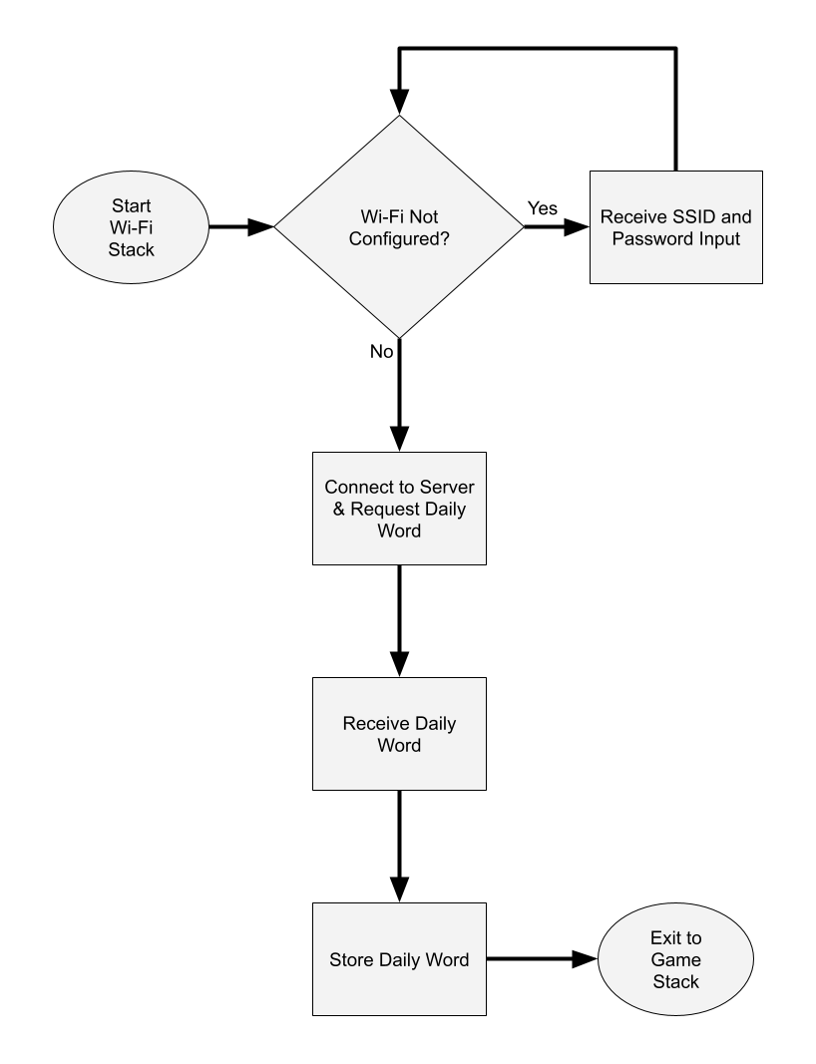
Software Design

Slide 27
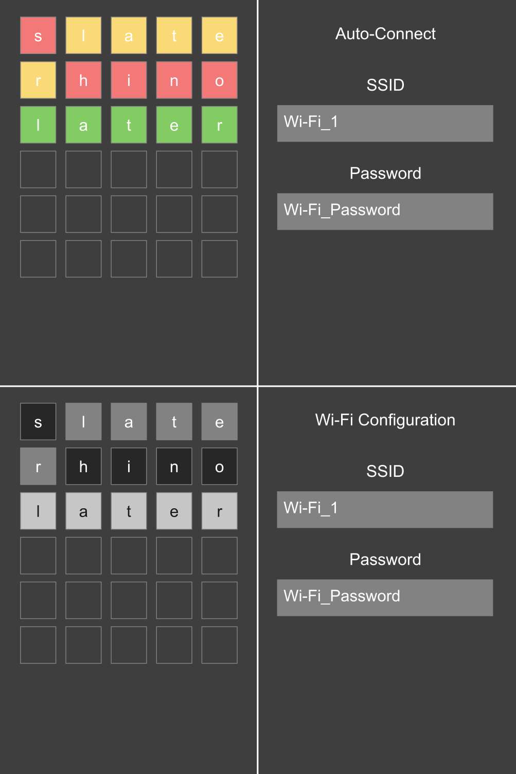
Software Design

Slide 28
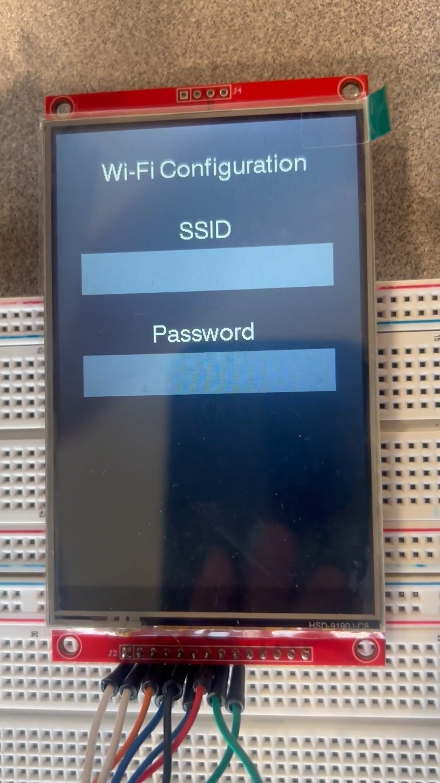
Prototyping and Testing
The first video is from an earlier state of development and shows display operation with a functional Wi-Fi Configuration screen and a Daily Word Game being played

Slide 29
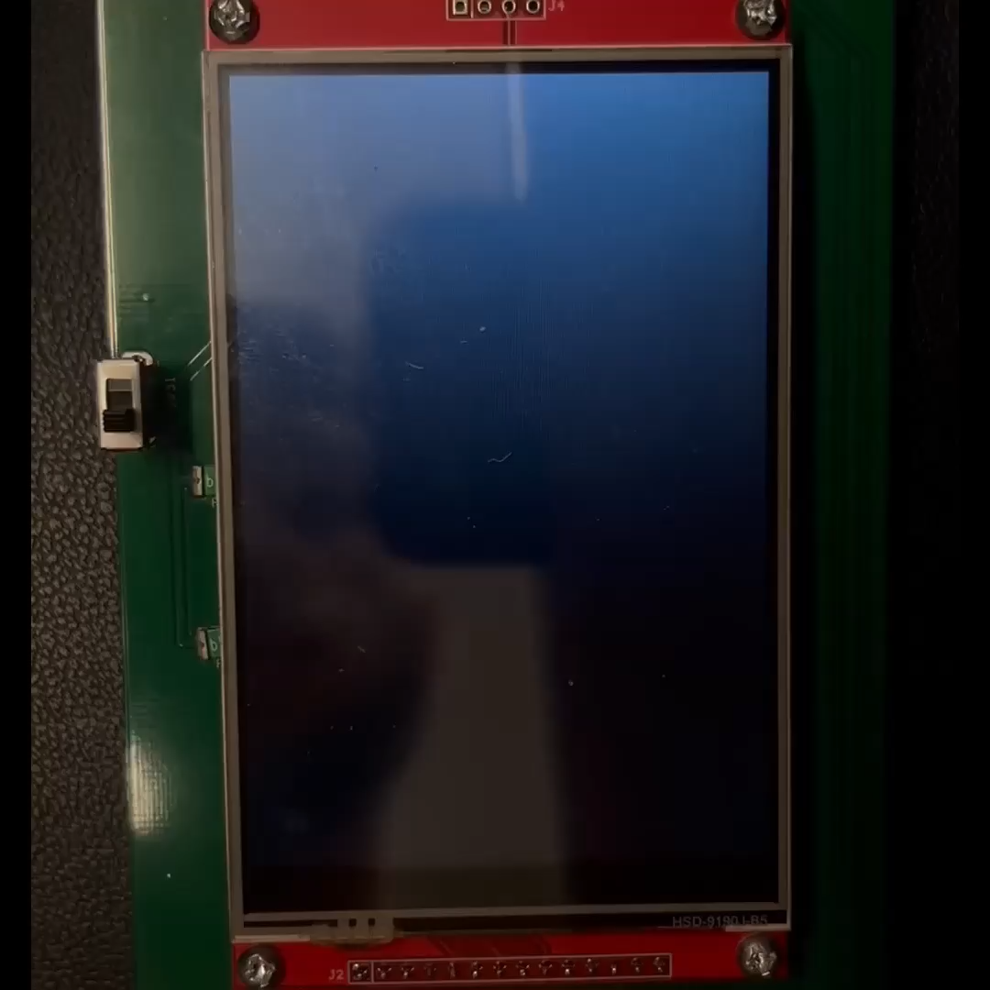
Prototyping and Testing
The second video is from a later state of development, and it shows the Auto-Connect screen, Wi-Fi Configuration screen, and a bit of a Daily Word Game being played

Slide 30
Prototyping and Testing
Arduino’s verification testing feature was used which helped with fixing up code.
Different issues were encountered like Serial not working after including display code and game/feedback display code not displaying correctly
These had different solutions. The Serial one was as simple as changing the port used on the Dev Kit and the latter involved multiple things like using fillScreen() instead of partial screen updating and letting the correct guess not leave early from the feedback stack

Slide 31
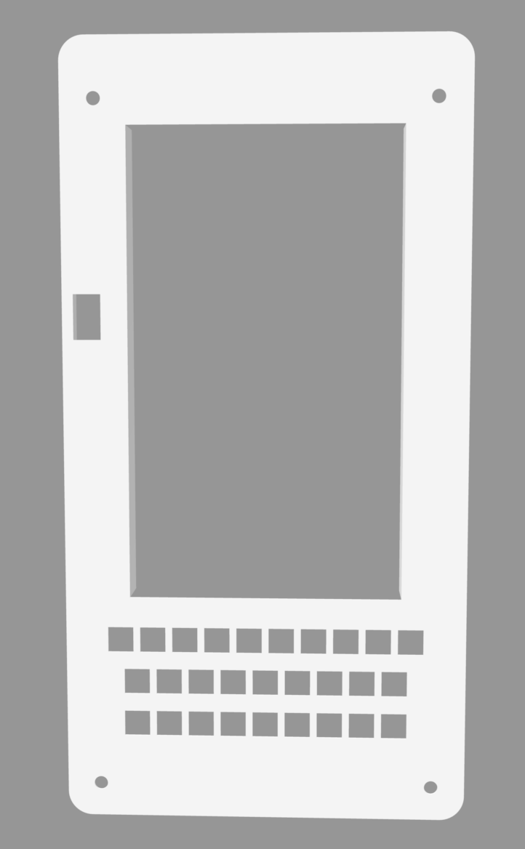
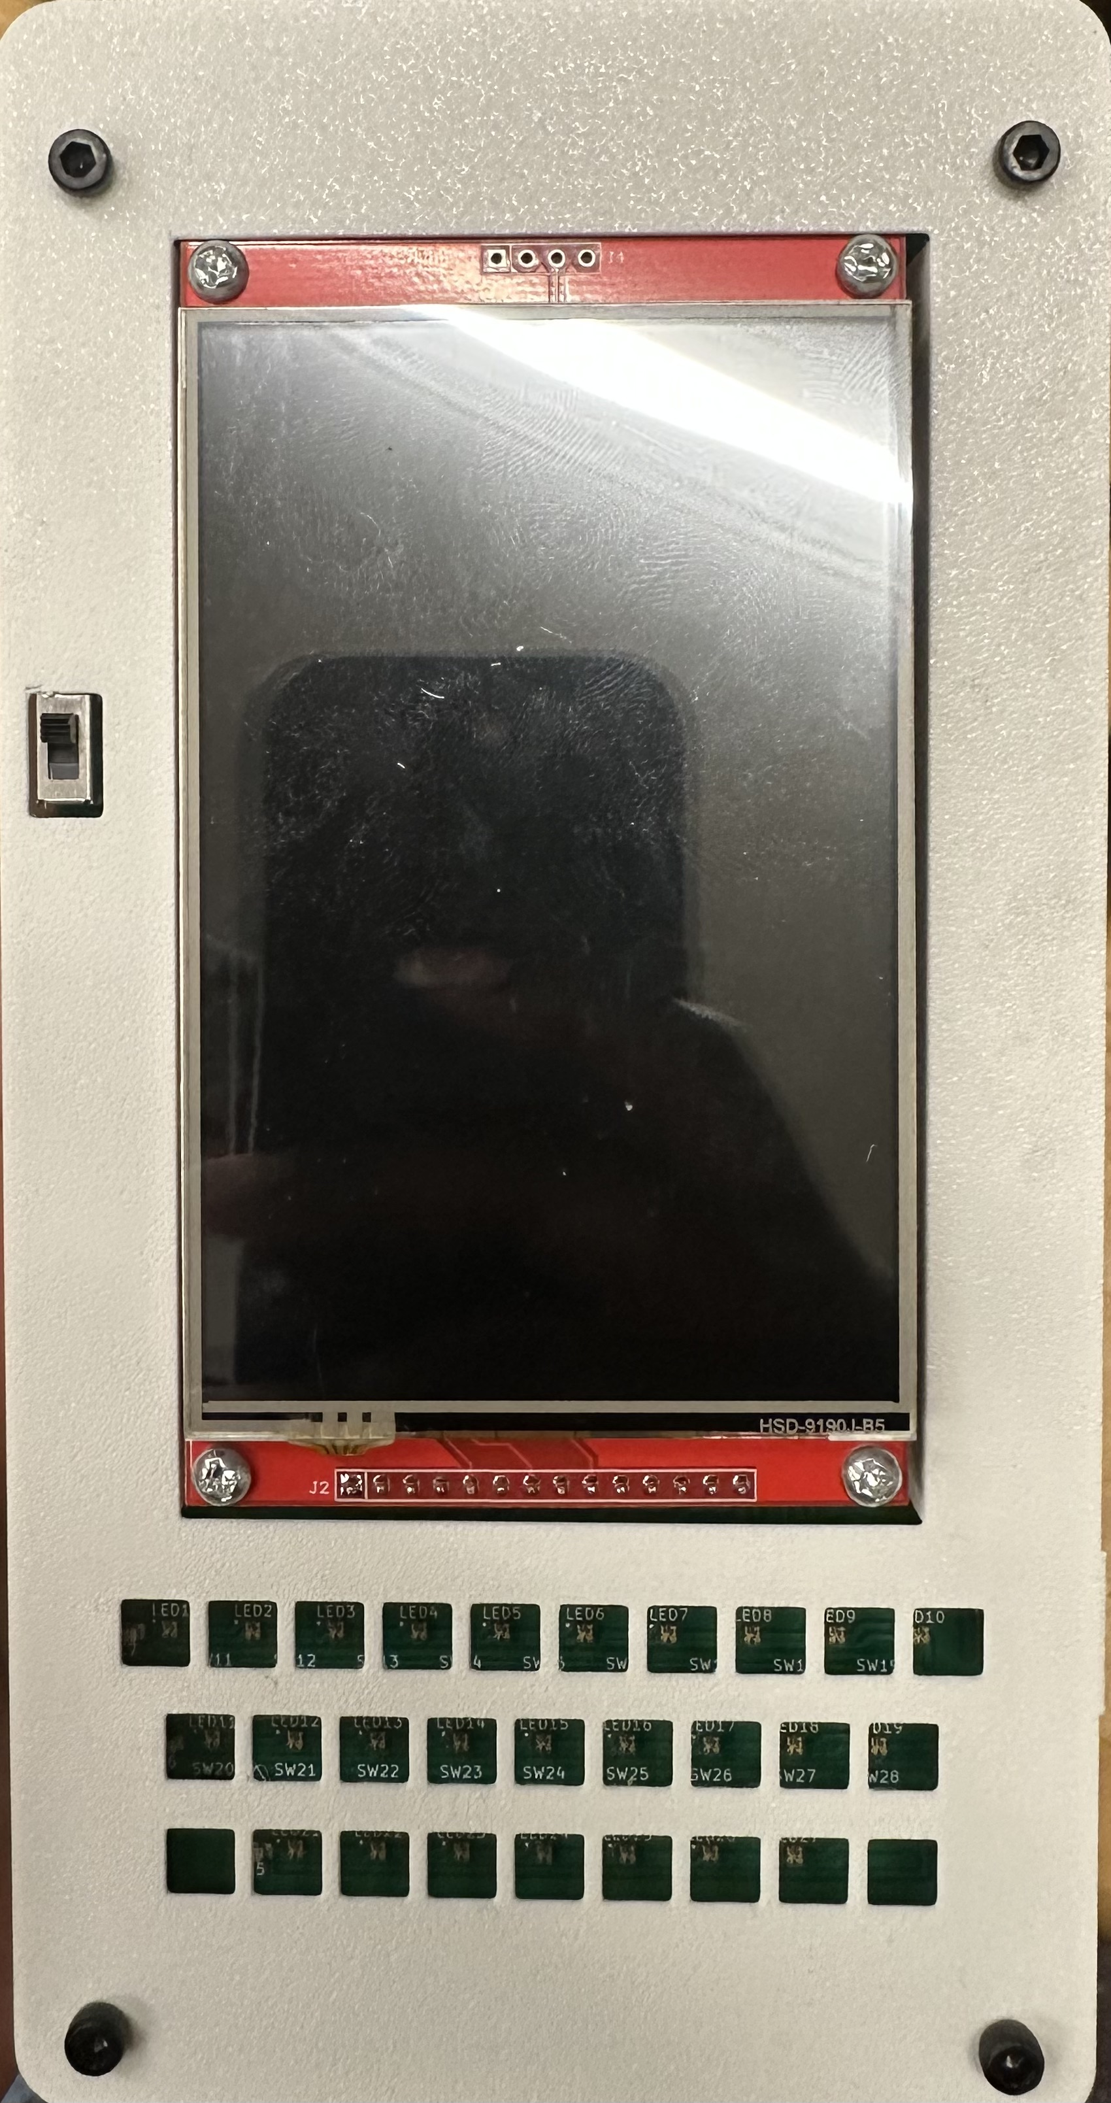
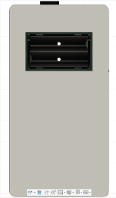
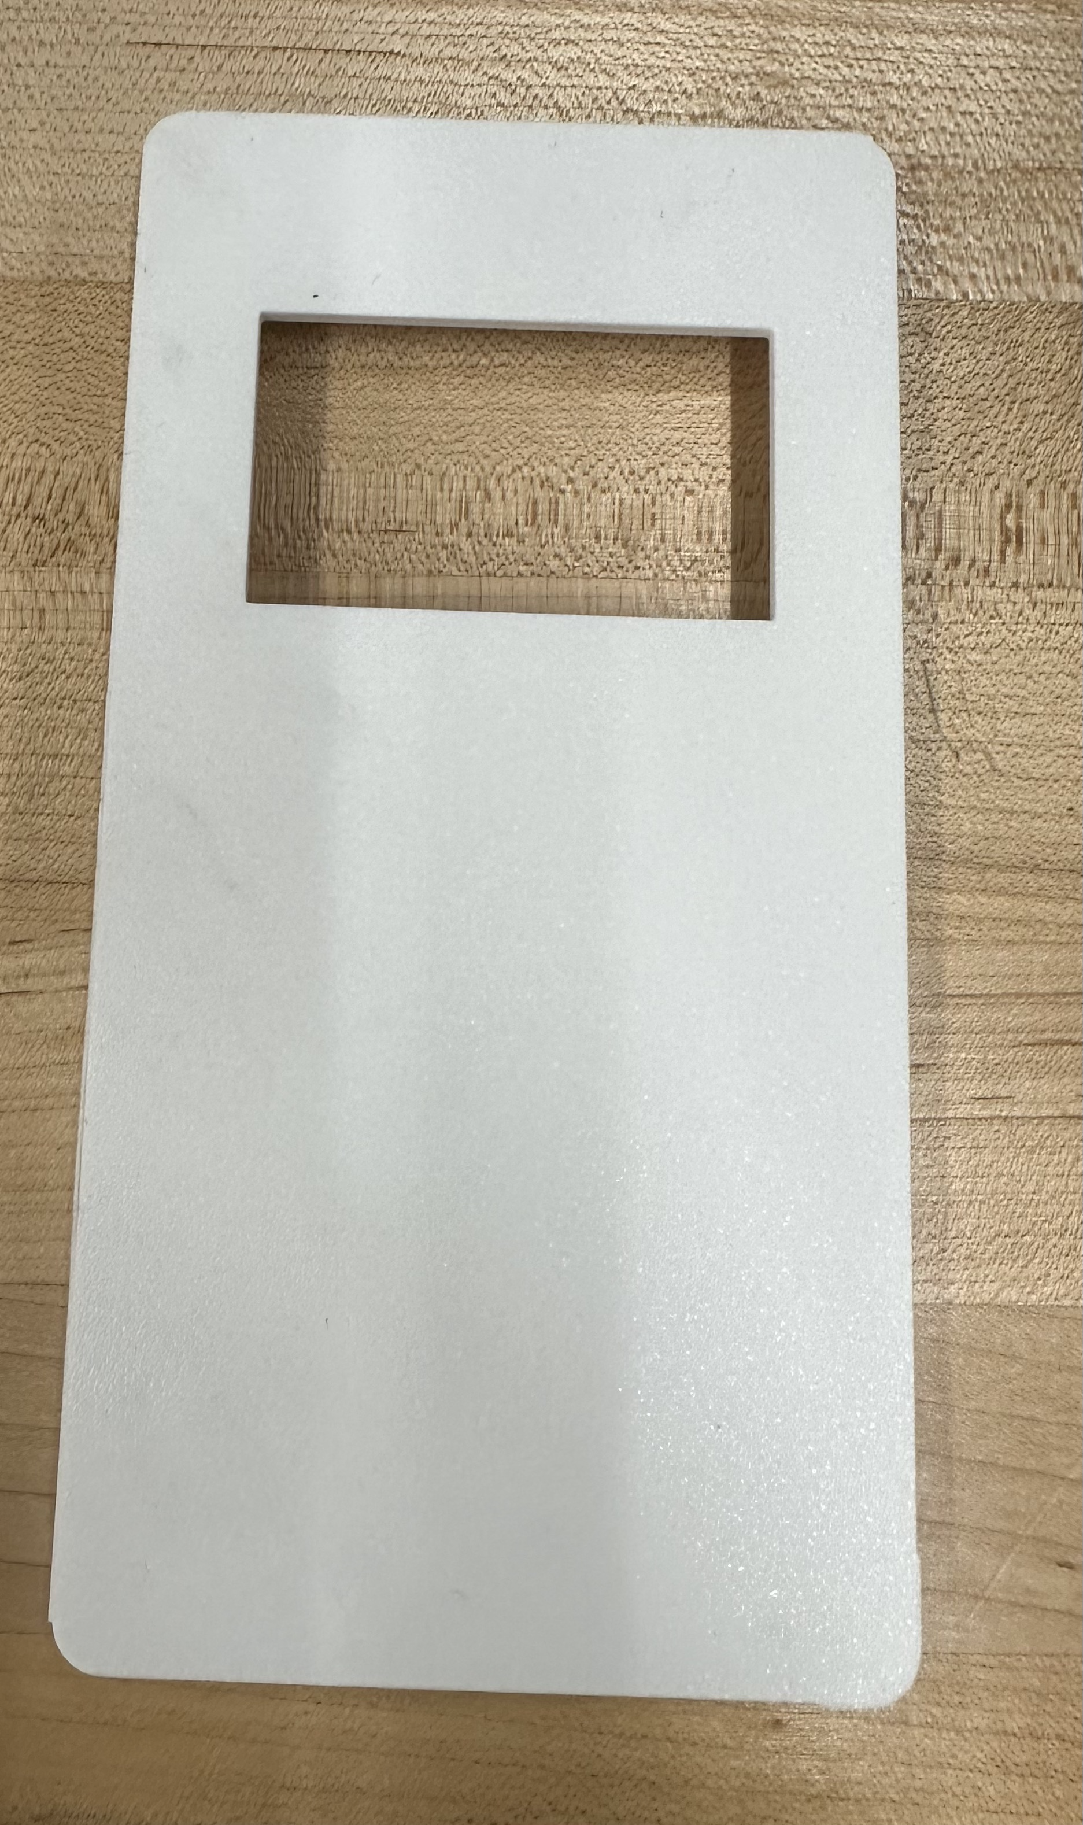
Enclosure Design
Top Case
Bottom Case

Slide 32
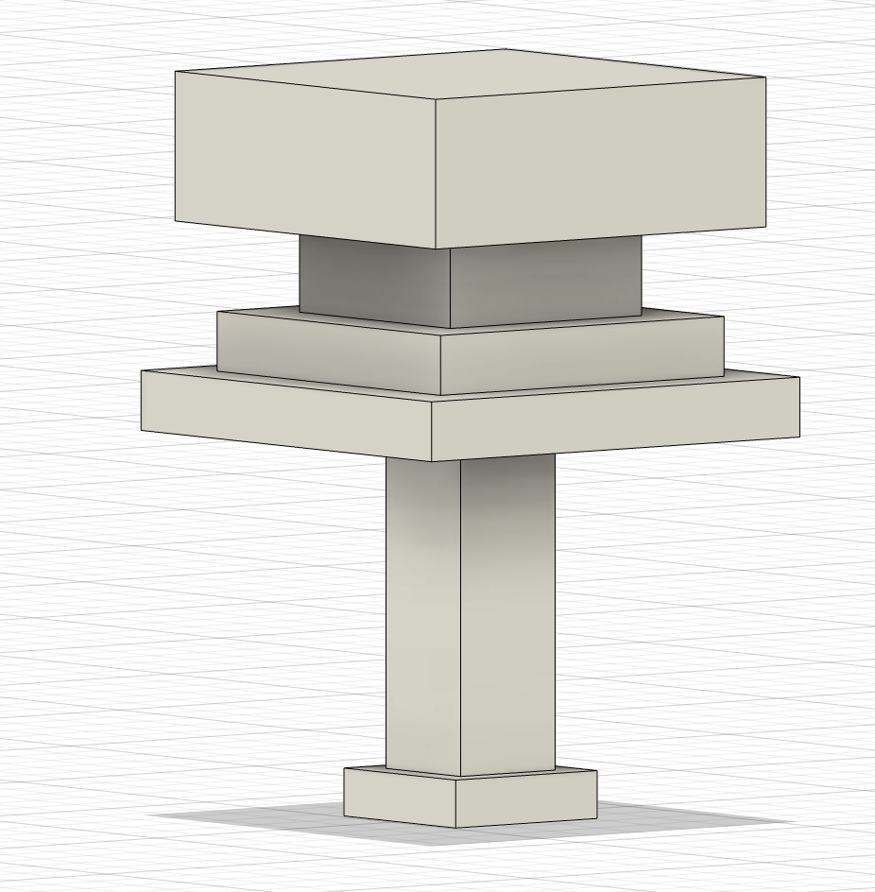
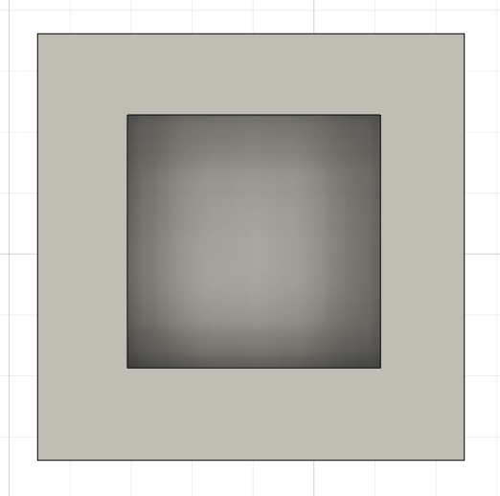
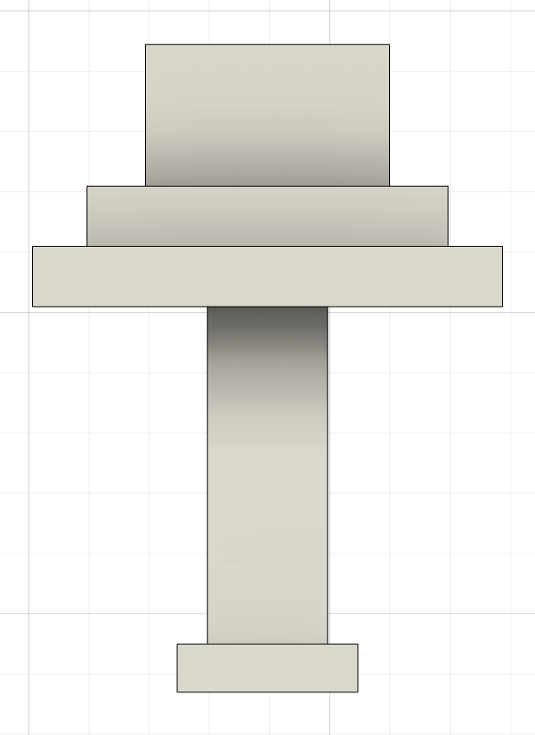
Key Integration
Keycap Assembly
Key Cutout (Top Case)
Key Stem

Slide 33
Budget
Component | Quantity | Price
PCB Fab. & Shipping | 1 | $183.65
ESP32-S3-DEVKITC-1-N8R8 | 2 | $30
ESP32-S3 WROOM Module | 3 | $18.39
Tactile Switches | 40 | $14.35
TFT LCD Display | 2 | $38.32
USB Connectors | 1 | $6.99
Voltage Regulators | 2 | $80
RGB LEDs | 40 | $14.04
NiMH AA Battery Pack | 2 | $69.65
M3 Screws | 1 | $9.99
Enclosure (PLA Filament) | 2 | $46.99
Keycap Labels (Stickers) | 1 | $12.99
Total |  | $525.36

Slide 34
Work Distribution
Element | Primary Assignee
Schematic Design | Nala
PCB Design/Assembly | Nala
Software | Daniel & Hilda
Enclosure | Hilda

Slide 35
Thank You
Group 36

